Slide 1

E-Scooter Share Pilot in Chicago
Ziyi Yang
CPLN 680- Advanced Topics in GIS

Slide 2
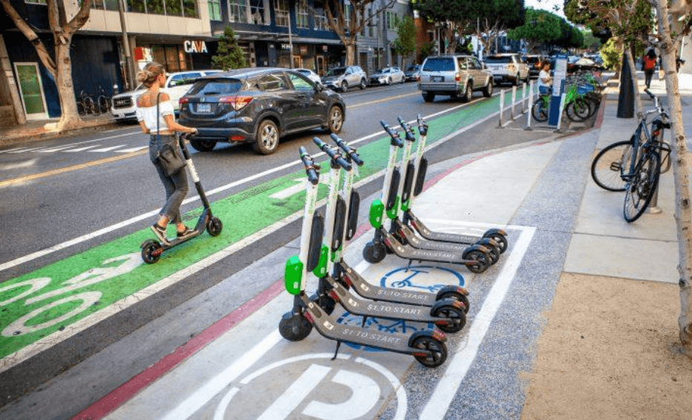
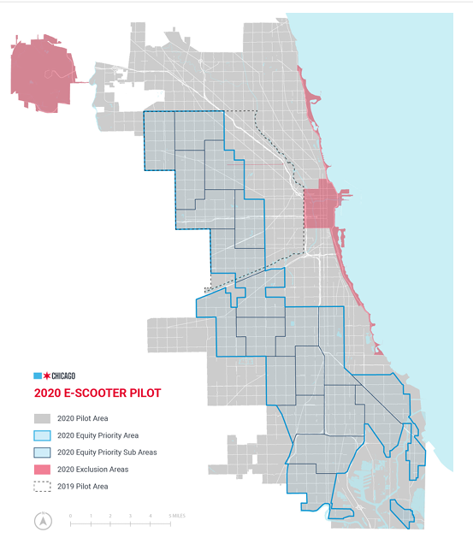
Time: August 12, 2020 to December 12, 2020
Vendors: Bird, Lime and Spin
Each company can offer 3,333 rentable scooters each day between 5 a.m. and 10 p.m.
Price: 1$ to unlock + Bird (32 cents/min)
Spin (39 cents/min)
Lime (19 cents/min in priority areas and 39 cents/min elsewhere)

Slide 3


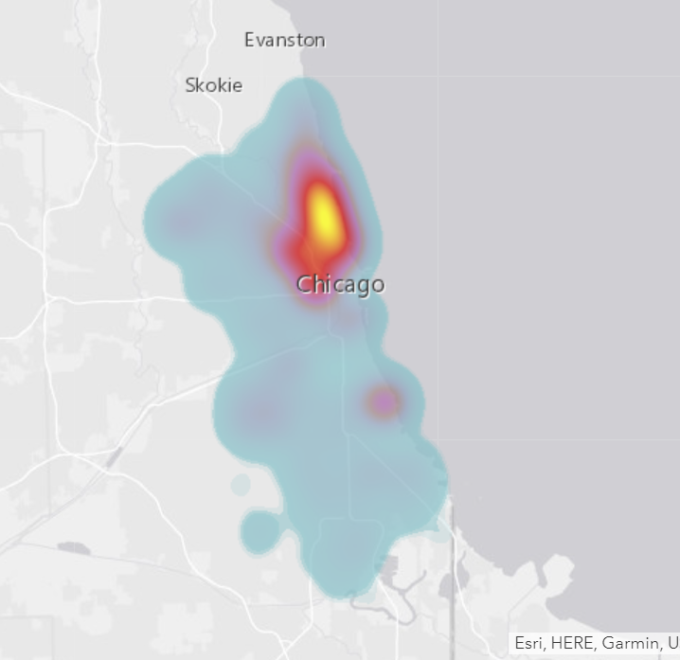
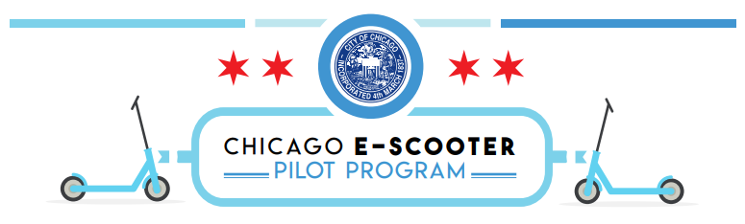
Questions: Who currently has access to scooters?
E-Scooter Trips 2020 (more than 630,000 trips)
Natural and Built Environment
Chicago Demographic Data-- US Census
Notes:
Job one for expanding transportation choices is shoring up current transit system, and then helping the communities connect to transit stops. so we need to improve local, block-by-block transit access for folks who are most in need: the middle- and low-income resident who are less likely to live within walking distance of a convenient bus or train option. Every neighbor deserves the same access to our entire city — a neighborhood network. shared e-scooters and e-bikes can provide that missing link, giving people the means to access transit stops that were previously accessible only by a long walk or expensive car ride.
Whether there is an imbalance in demand for Scooter and whether it will give residents an unfair right to use the scooter will be determined by the following features. vehicle flow imbalance happens when riders take more vehicles from one place than other riders bring in. from map most trips take place in the North-East of the city. If suppliers do not rebalance aggressively, vehicles will be concentrated in a few regions and user in other region will not have scooter in time.
To solve this, we will build a model using these features, including the city's demographic characteristics, socioeconomic and natural & built environment characteristics, to make predictions.
Designed to help city officials have a better understanding of the current scooter accessibility and predict the geographic distribution of scooter riders in this year and understand its relationship to the social and economic geography of the city.

Slide 4
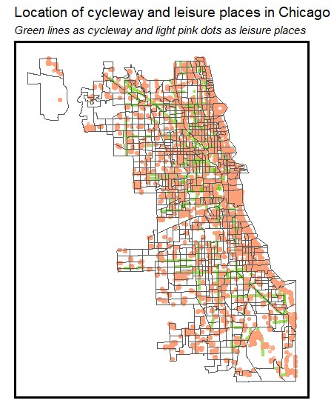
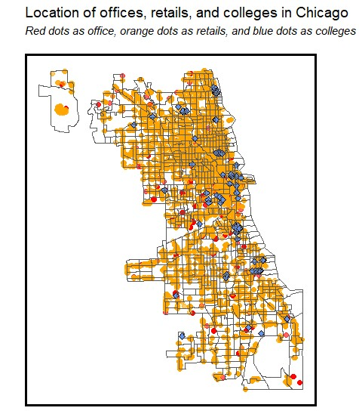
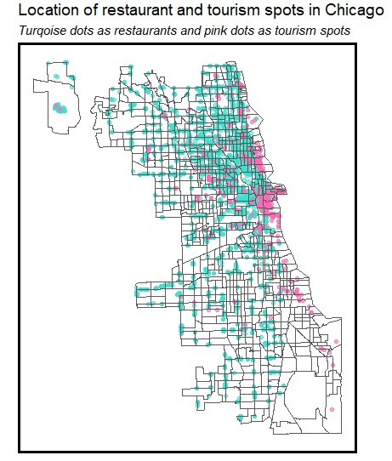
Demographic
Total Population
Median Age
Percentage White Population
Percentage Female Population
Socio-economic
Household Income
Home Values and Rental Prices
Commute Modeshare (transit v driving)
Commute Distance (30+ minutes)
Housing Units and Occupancy Rates
Vehicle Ownership
The Number of Jobs
The Number of Workers
Built Environment
Retail Stores
Restaurants
Leisure Activities and Tourism Destinations
Transportation Infrastructure
Offices
College

Slide 5
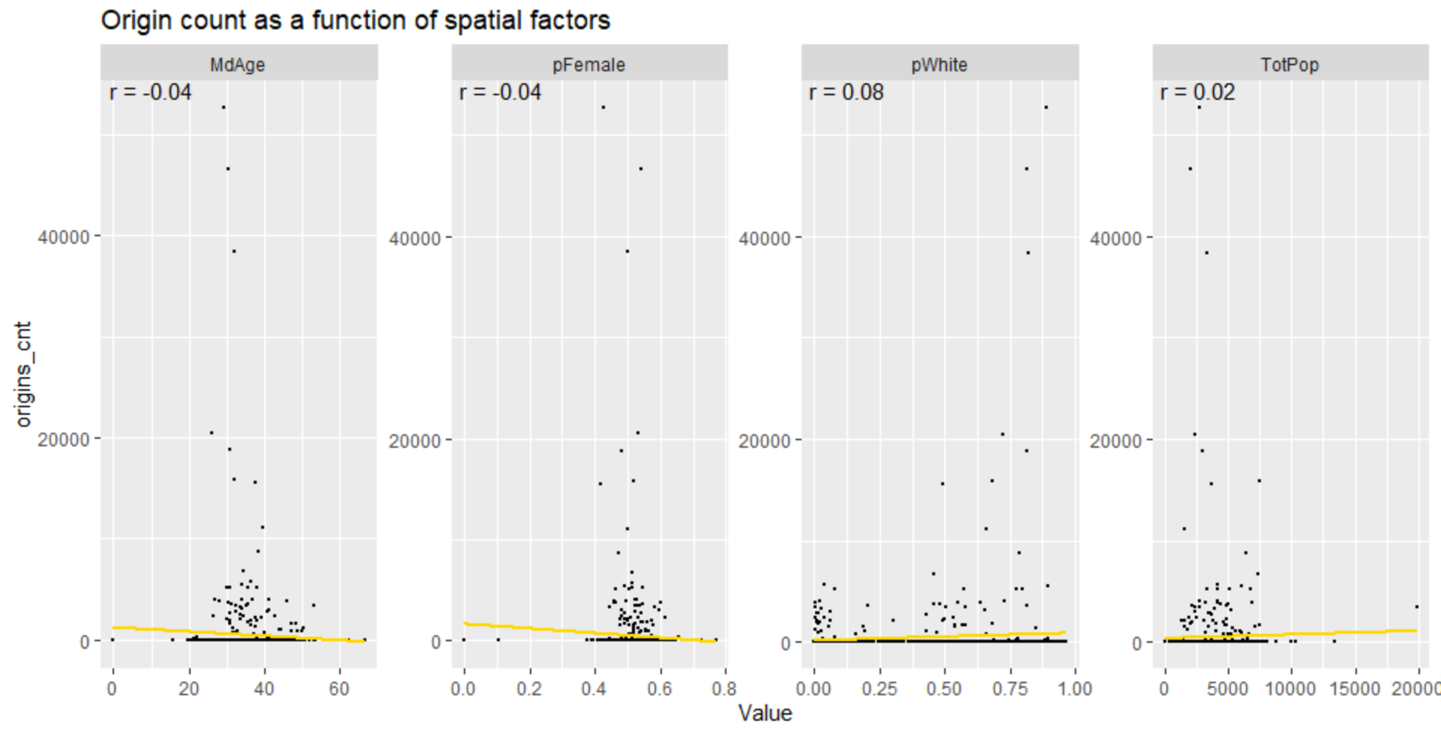
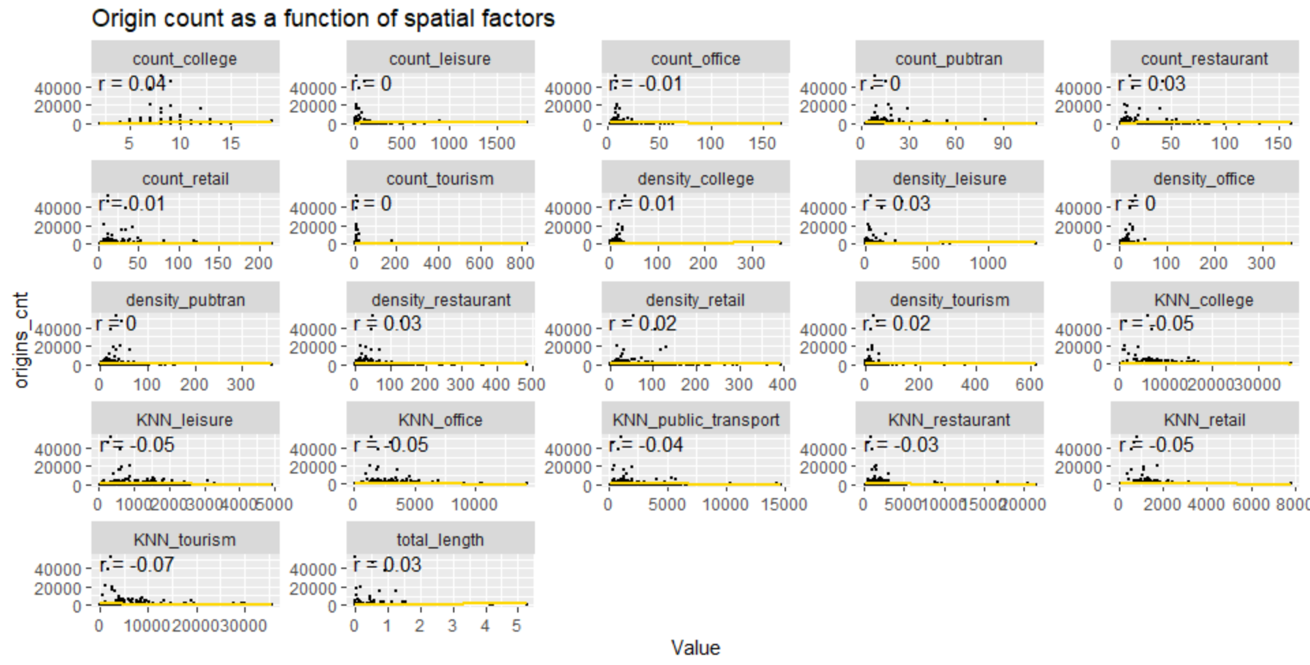
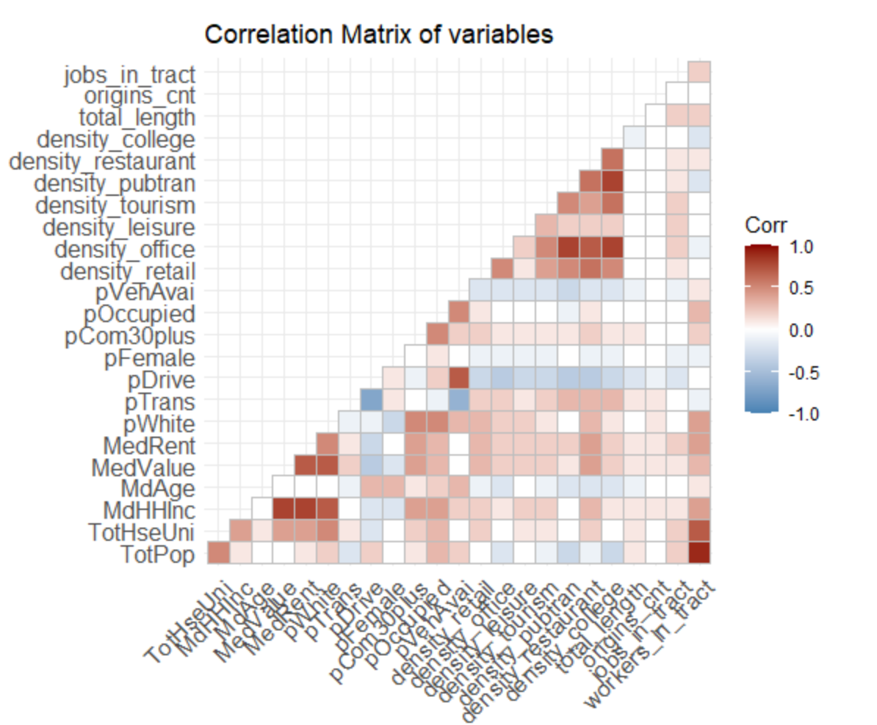
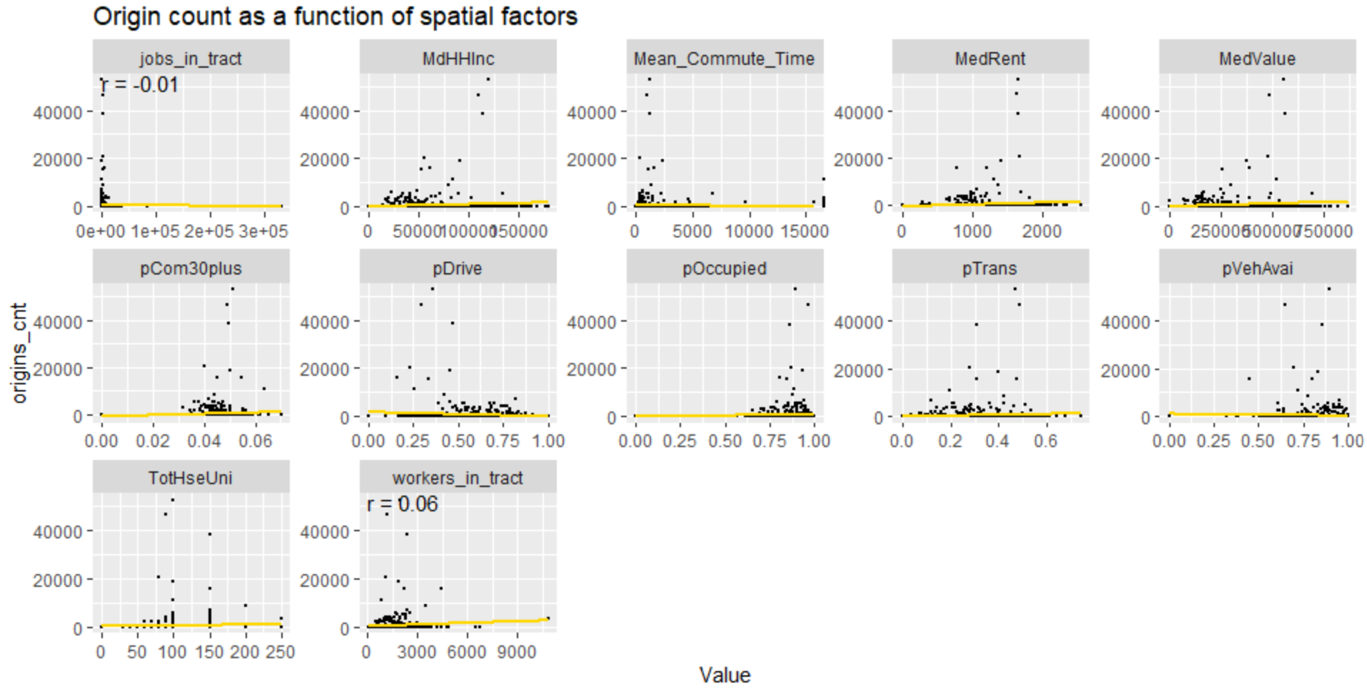
Demographic
Built Environment
Socio-economic
Correlation Matrix

Slide 6
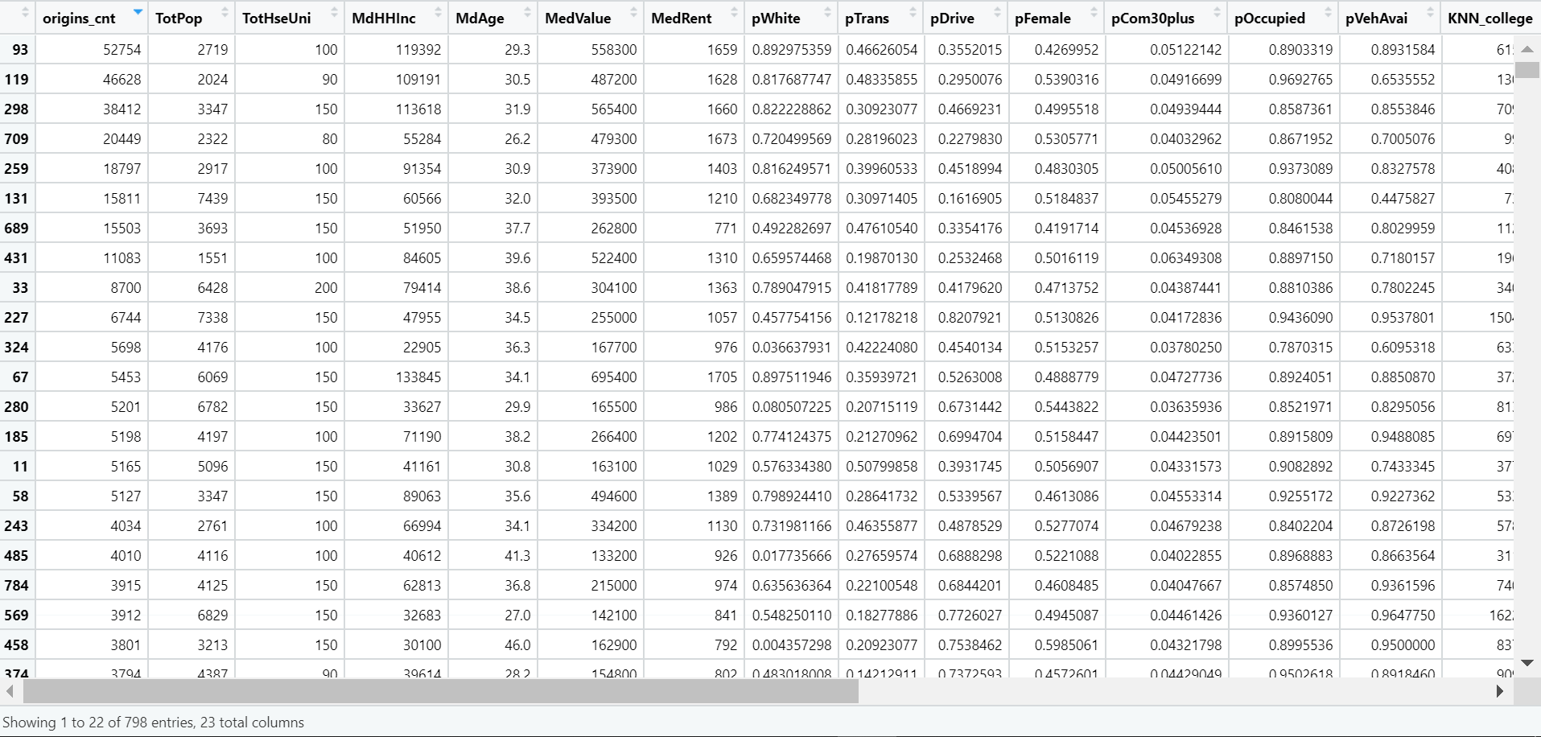
Data Panel
Model Building:
Linear Regression Model
R-squared: 0.02647
Notes:
Our final model uses 22 features built from these variables as predictors for scooter ridership in a census tract. Our data panel looks like this

Slide 7
Future works:
Adjust variables?
Run Another Model –
random forest or random decision forest is an ensemble learning method for classification, regression, and other tasks that operates by building a large number of decision trees at training time. Random decision forests correct the habit of decision trees to overfit their training set.
Model Performance
Prediction
Priority Area/Rebalance

